Slide 1
Can We Beat “Same as Today”? Predicting Chicago’s Weather

Slide 2
The Question

Slide 3
“Can we predict tomorrow’s weather in Chicago from today’s data, and does anything beat ‘same as today’?”

Slide 4
Context

Slide 5

The Data: Daily US weather data (temperature, rain, wind) for 2009 and 2010.
The Challenge: Weather changes slowly; consecutive days are nearly identical.
Testing Rules: Train on 2009, test on 2010. Mixing days would cause the model to memorize rather than predict the future.
Measuring Success: Mean Absolute Error the average rainfall prediction error in millimeters (lower is better).

Slide 6
Exploratory Data Analysis

Slide 7
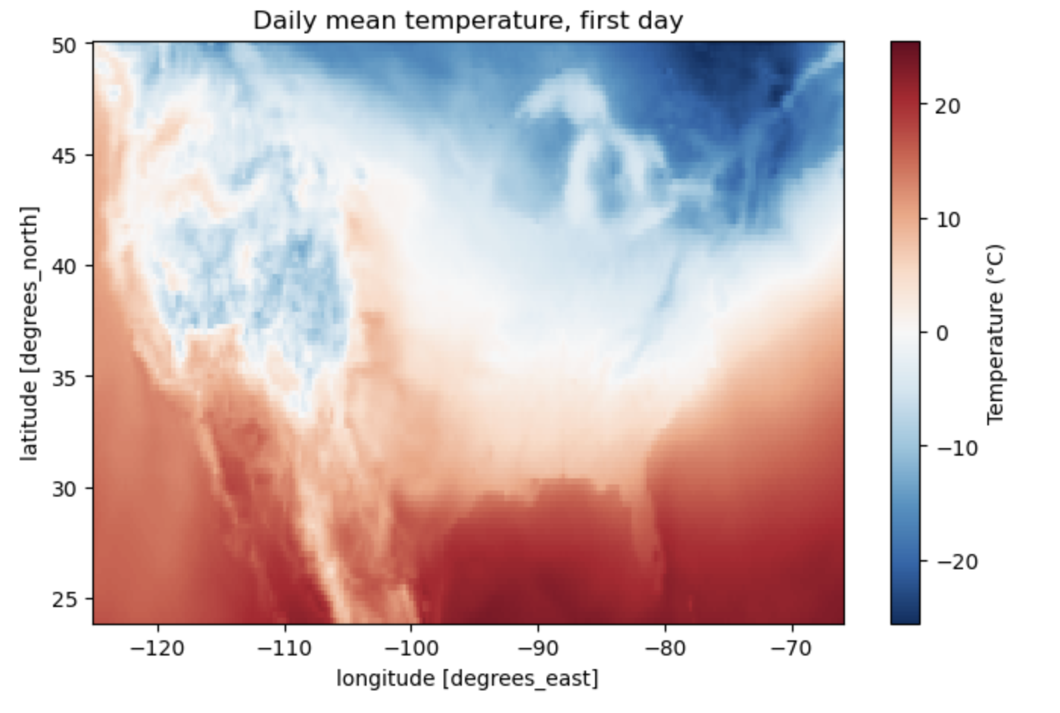
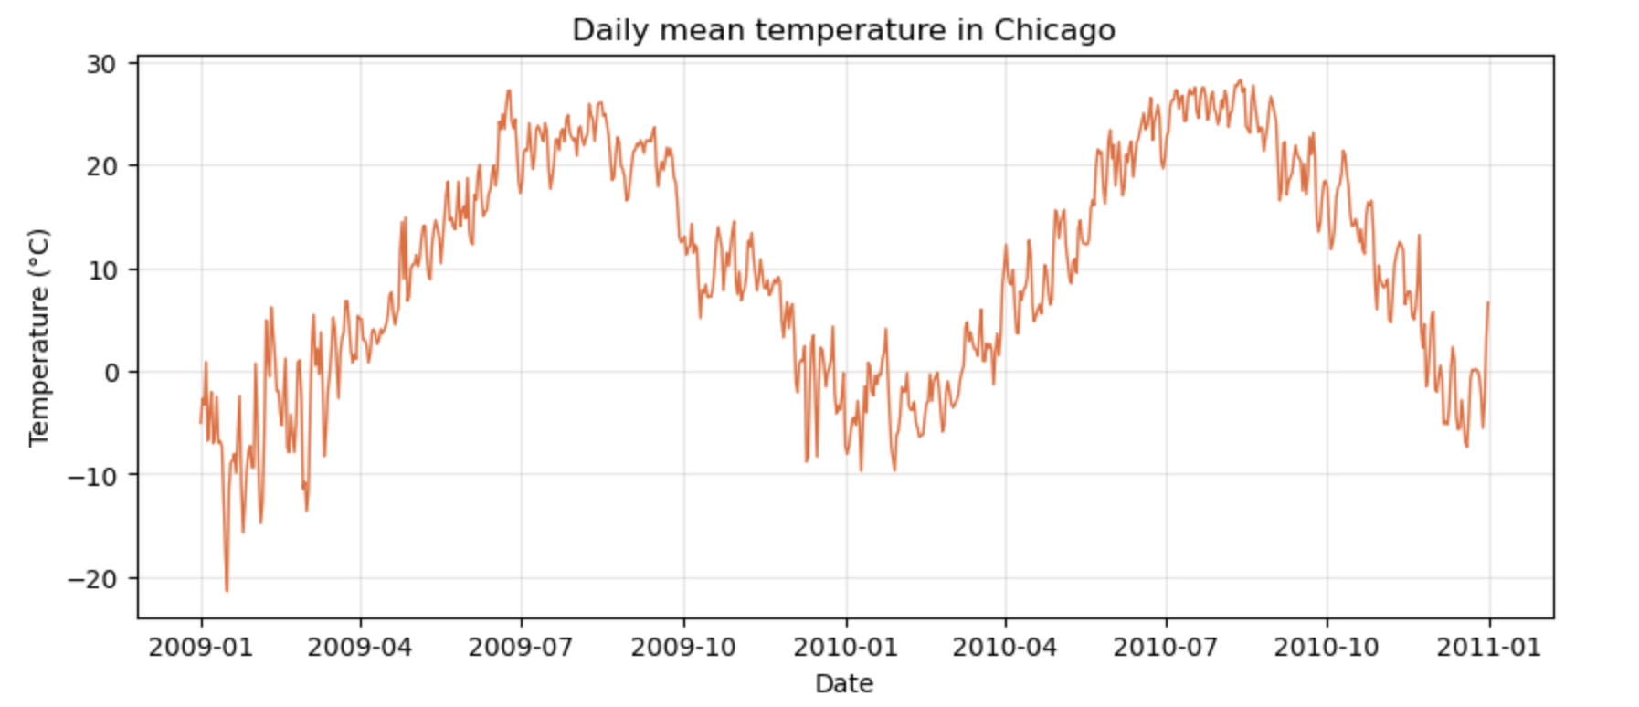
Exploratory Data Analysis
There is a clear color shift from red (South/Warm) to blue (North/Cold). This confirms that temperature is dependent on latitude.
The most obvious feature is the graph pattern. It shows the natural cycle of summer (peaks near 30°C) and winter (dips below -10°C). Very day to day
The map tells us where it is cold, but the graph tells us when it is cold. If you were to plot the graph for a location in Southern Texas (bottom of the map), the winter dips would be much less severe than the Chicago graph

Slide 8
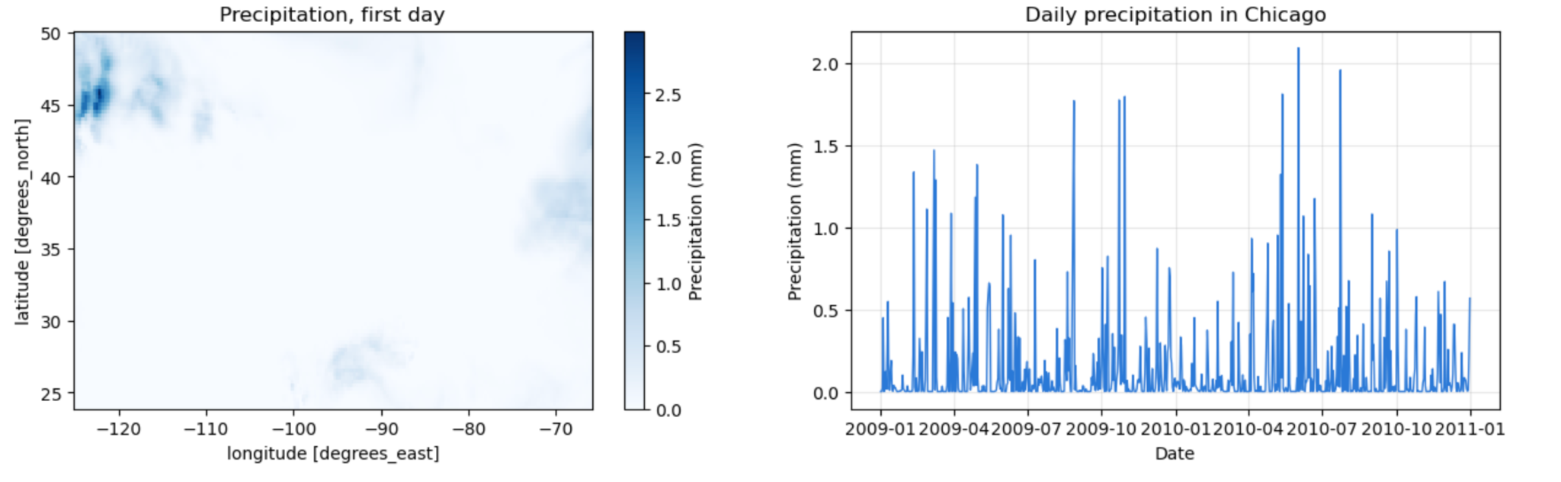
Exploratory Data Analysis
Unlike temperature (which is smooth), rain is highly localized. On any given day, it might be raining heavily in one spot (dark blue) while the rest of the country stays completely dry (white).
Daily rain in Chicago over two years. Rain isn't a steady stream; it's mostly flatlines (dry days) interrupted by sudden spikes (storms). This makes predicting precipitation much harder than predicting temperature.

Slide 9
Daily Averages

Slide 10
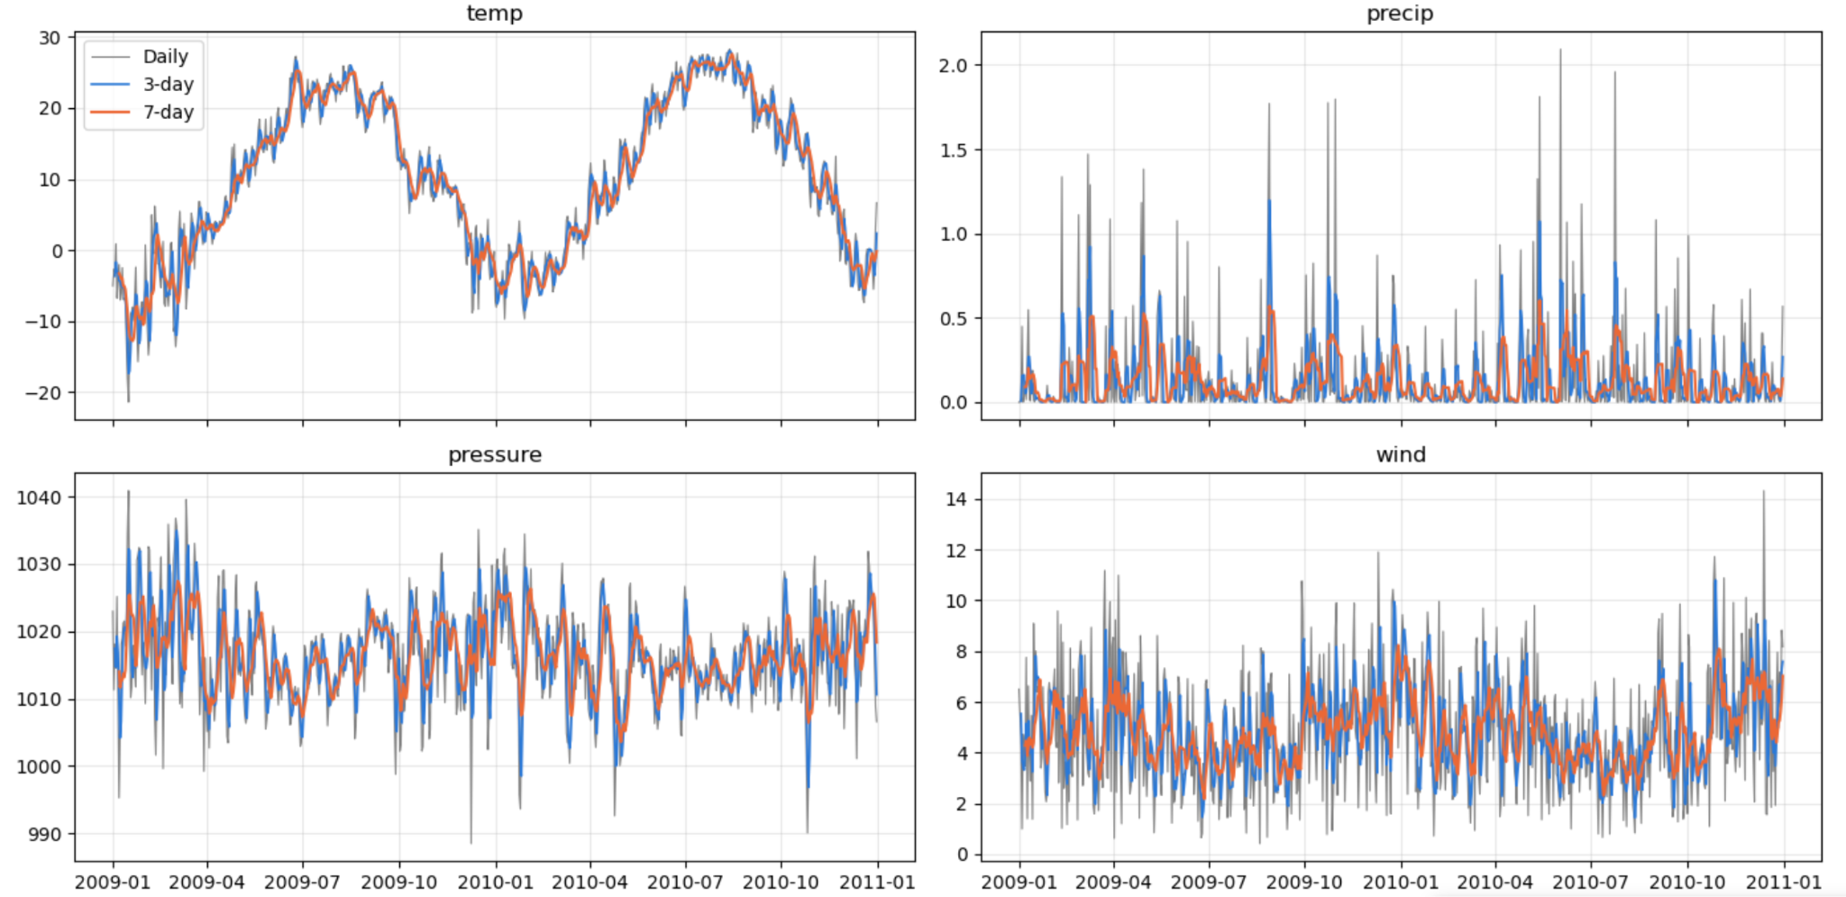
Daily: Raw daily data is very "noisy" and jumps around drastically.
3 Day: A short-term average. It smooths out day-to-day jumps.
7 Day: A weekly average. It reveals the true underlying trend, removing the chaos of daily weather.

Slide 11
Train/Test

Slide 12
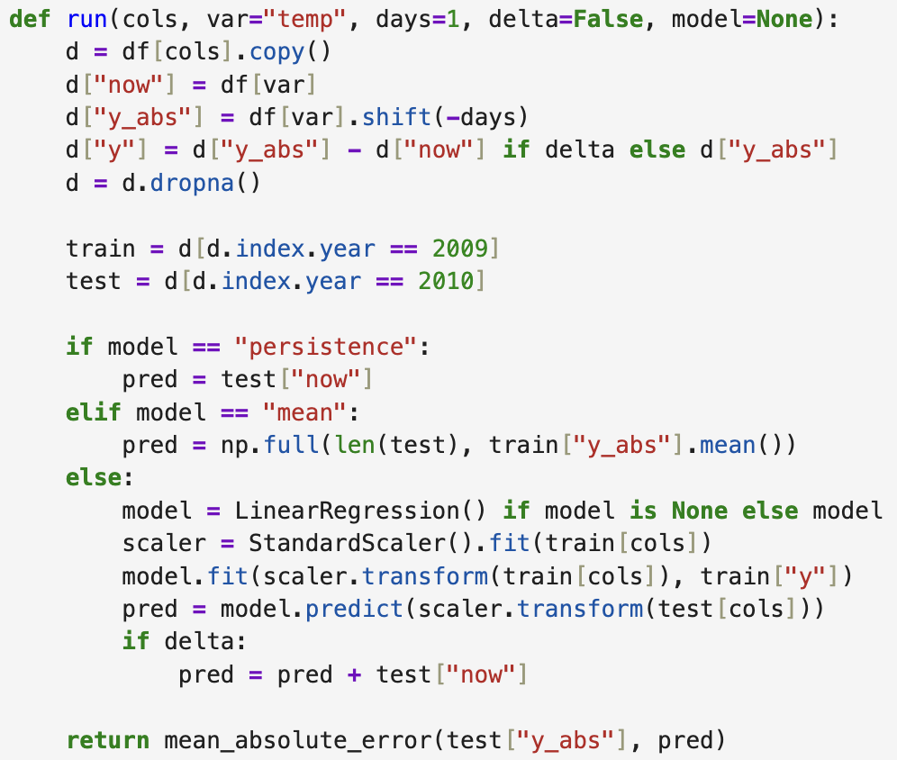
Train/Test
The Setup: A single function handles data prep, splitting, and evaluation.
The Split: Hardcoded to Train on 2009 (past) and Test on 2010 (future). No data leakage.
The Competitors:
Persistence: "Tomorrow will be the same as today."
Mean: "Tomorrow will be exactly average for the year."
Linear Regression: Our actual Machine Learning model.

Slide 13
Tomorrow’s Temp

Slide 14
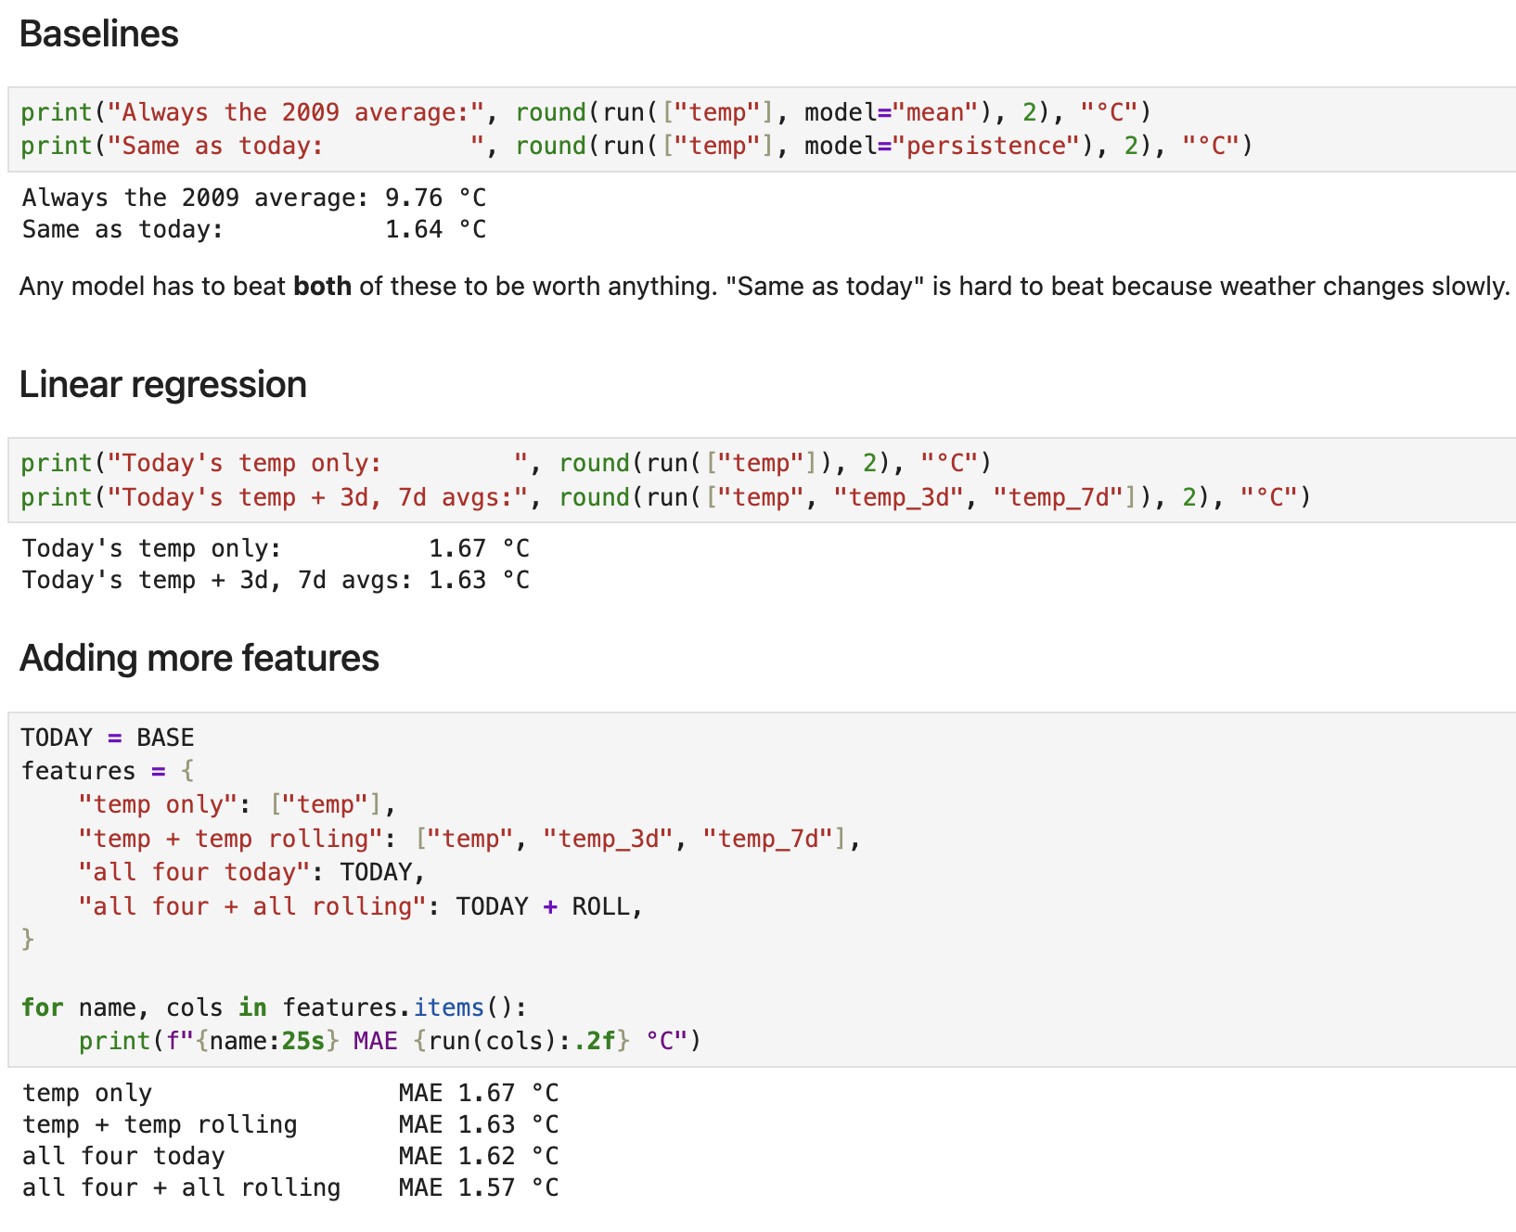
Tomorrow’s Predictions
The Baselines (The bar to clear): A model must beat both a "blind average" (9.76°C error) and "same as today" (1.64°C error).
The AI (Linear Regression): Just using today's temp (1.67°C) actually fails to beat the baseline.
Adding Features: By feeding the model 3-day and 7-day averages, plus other weather variables (wind, pressure), we get the best score: 1.57°C.

Slide 15
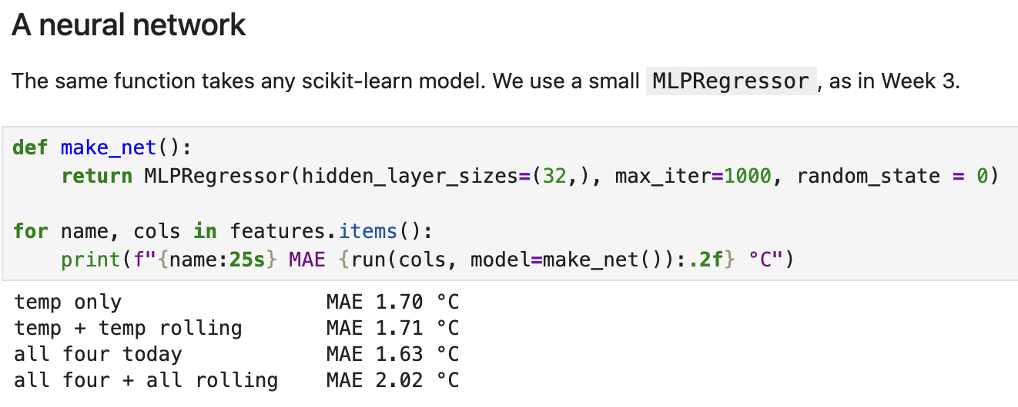
Tomorrow’s Predictions
Testing a Neural Network (Deep Learning)
The Upgrade: We swapped the simple linear model for a Neural Network (a more complex AI).
The Expectation: It should find deeper patterns and score better.
The Reality: It actually performed worse (MAE 2.02°C when given all data).
Why? "Overfitting." The model is too complex for this amount of data, so it memorized the past instead of learning general rules.

Slide 16
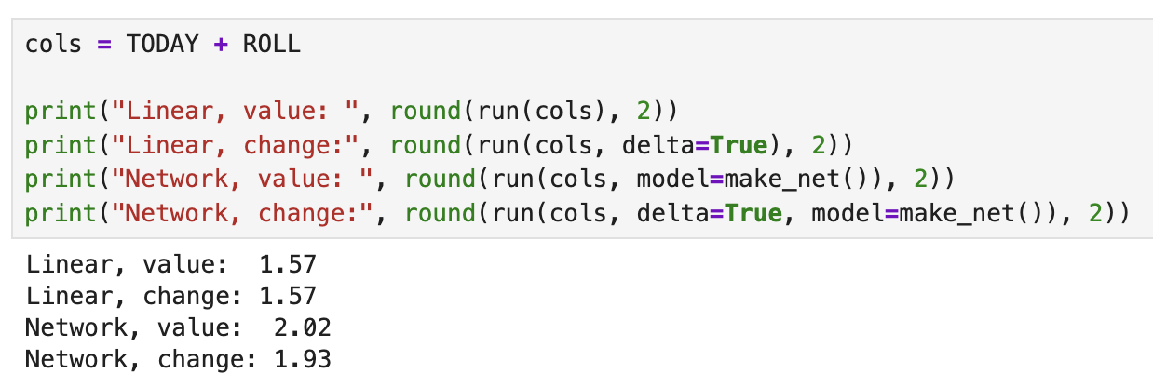
Predict the Change
The Setup: We tested two ways to ask the AI the question.
Value: Predict the exact temperature tomorrow.
Change (Delta): Predict how much warmer or colder it will be compared to today.
The Result: The Linear model didn't care (1.57 both ways).
The Surprise: The Neural Network got dramatically better (2.02 → 1.93) when asked to predict the change instead of the total value.

Slide 17
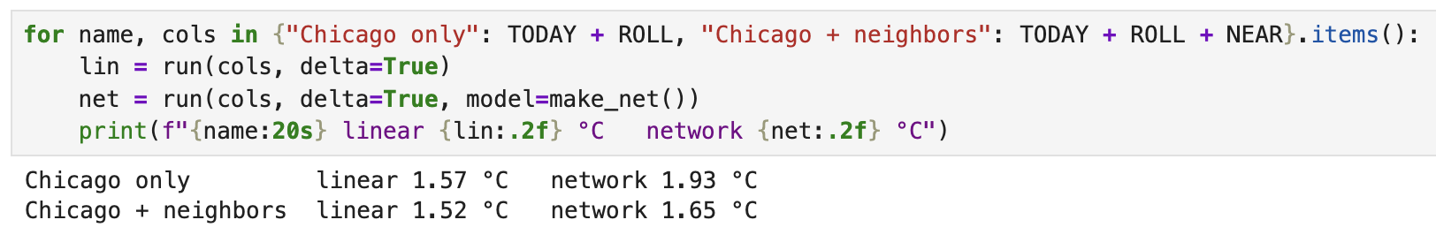
Using Neighbors
The Setup: We compared looking at Chicago alone vs. Chicago + its surrounding region ("neighbors").
The Idea: Storms move across the map. If the model can see what is happening to the West, it can predict what is coming to Chicago.
The Result: Both models got smarter.
The Winner: Linear Regression with neighbors hits 1.52°C (our best score yet!).

Slide 18
Predicting Further Ahead

Slide 19
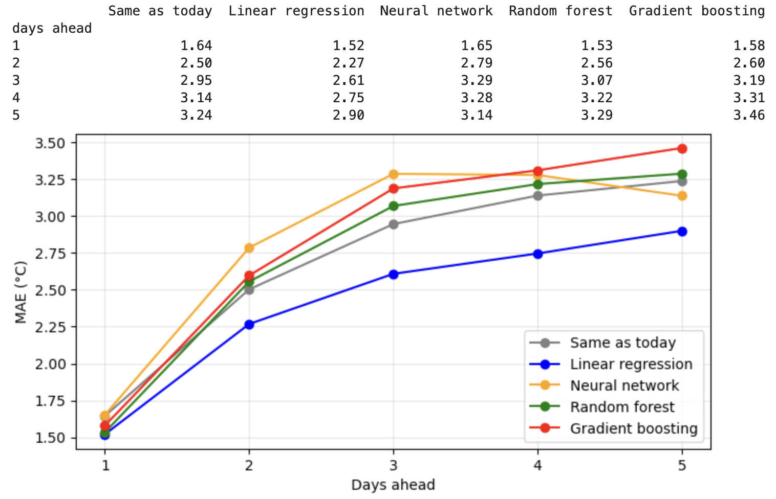
Predicting Further Ahead
The 5-Day Forecast Showdown
The Goal: Predict temperature 1 to 5 days into the future.
The Trend: All lines go up. The further out you look, the harder it is to predict (errors increase).
The Winner: Linear Regression (the blue line) is the clear champion. It stays the lowest across all 5 days.
The Loser: The complex Neural Network (orange line) is actually the worst at 5 days ahead.

Slide 20
Precipitation

Slide 21
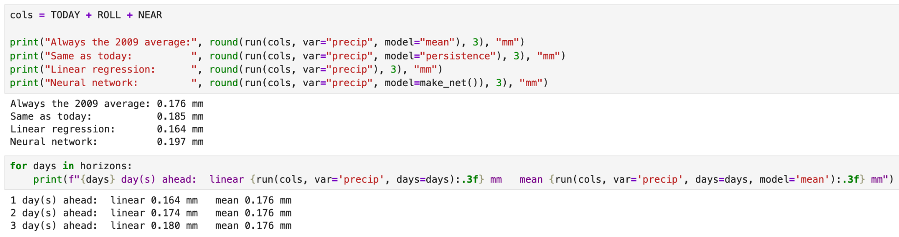
Precipitation
The Challenge: Rain is mostly zero, with occasional sudden spikes (as seen earlier).
The Short-Term Win: For tomorrow (1-day), the Linear model is best (0.164 mm).
The "Dumb" Baseline Wins: By day 3, the simple "2009 average" model actually ties the Linear model.
The Takeaway: Rain is so chaotic that the model can't beat a simple average beyond a 2-day forecast.

Slide 22
Extreme Heat Days

Slide 23
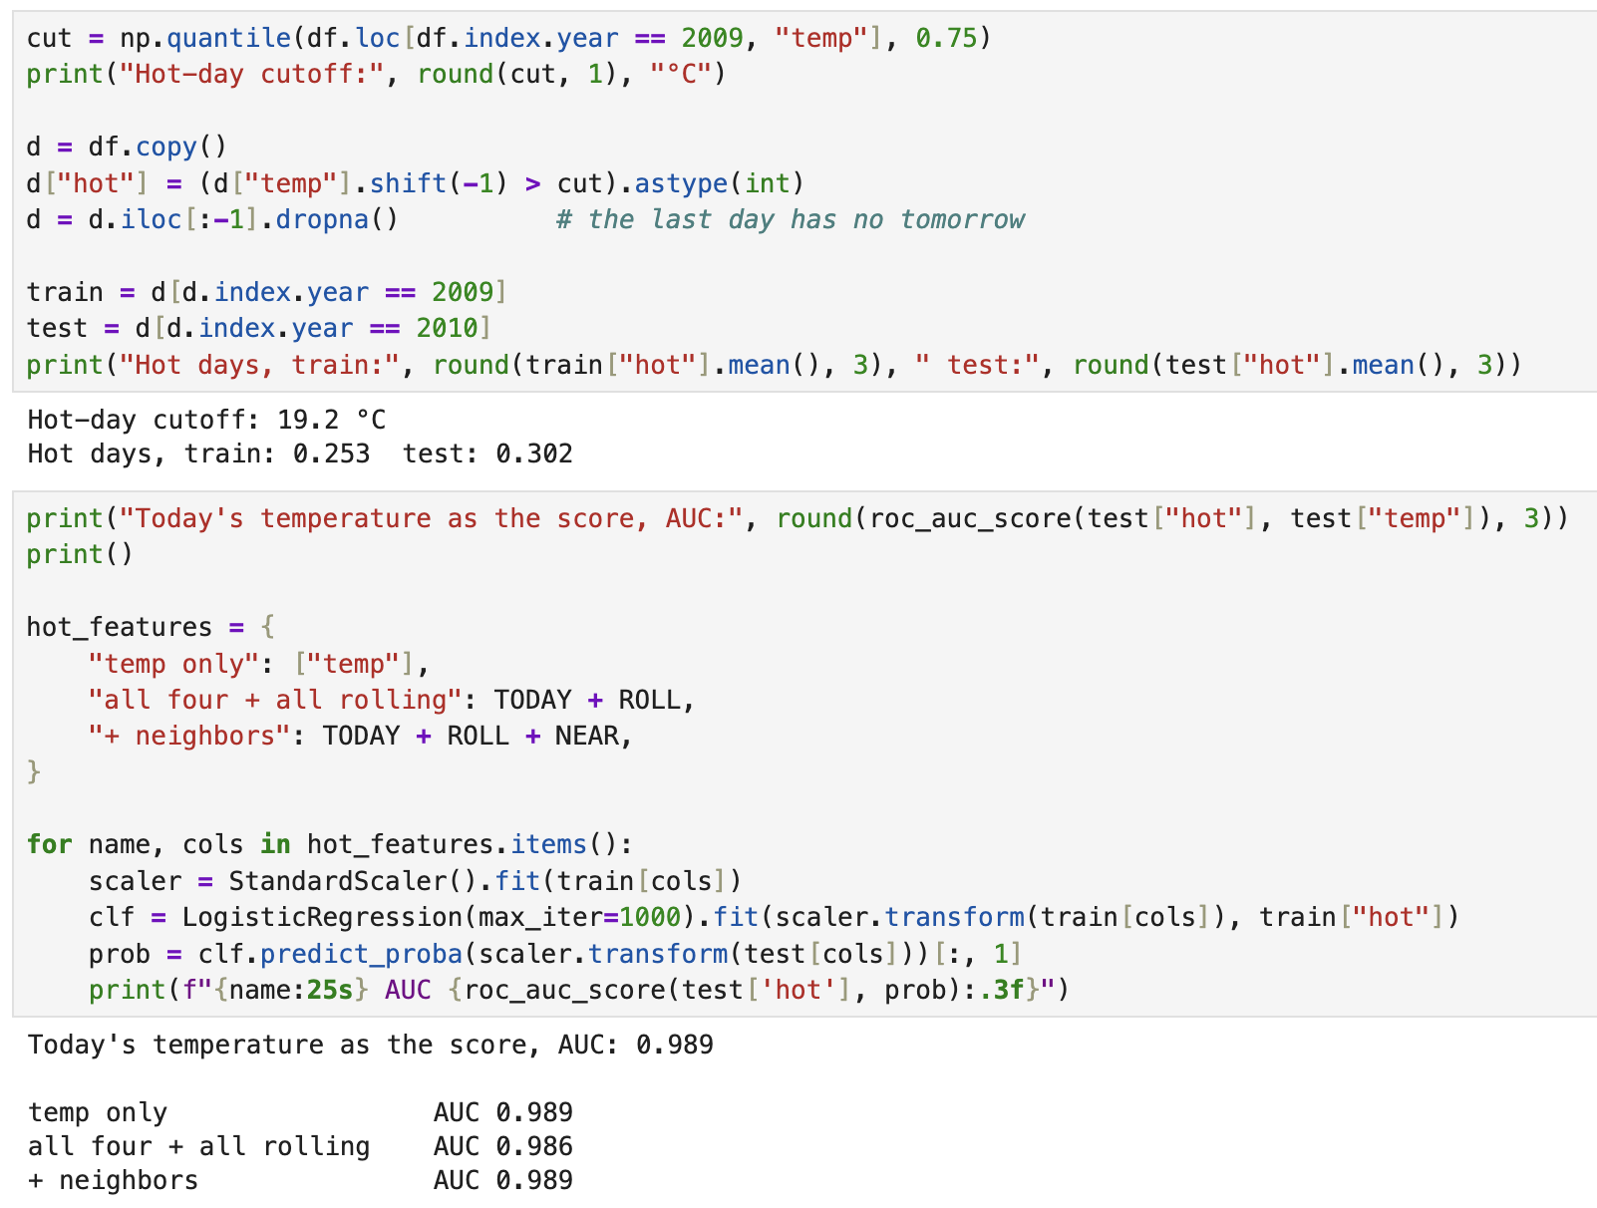
The Definition: A "Hot Day" is anything above 19.2°C (the top 25% of 2009).
The Score: We switched to AUC (Accuracy Score). 1.0 is perfect.
The Results: All models scored incredibly high (~0.989).
Takeaway: Predicting extreme heat is much easier than predicting rain. Even just knowing today's temperature is almost 99% accurate.

Slide 24
The Data: 2 years of daily US weather. We used a strict "Train on 2009, Test on 2010" split to prevent the model from cheating.
Temperature is Predictable: Simple models (Linear Regression) beat complex ones. By adding "neighbors" (spatial context) and 7-day trends, we achieved our best score (1.52°C error).
Rain is Chaotic: Rain is "bursty" and localized. Beyond a 2-day forecast, AI cannot beat a simple historical average.
Big Lesson: More complex Model (Neural Networks) does not always equal better results. Simple models often win with the right data.
Summary

Slide 25
THANKS!

